Slide 1

“Invest Safely, Grow Confidently.”

Slide 2

AGENDA
INTRODUCTION
TECHNOLOGY AND TOOLS
KEY FEATURES
CONCLUSION

Slide 3
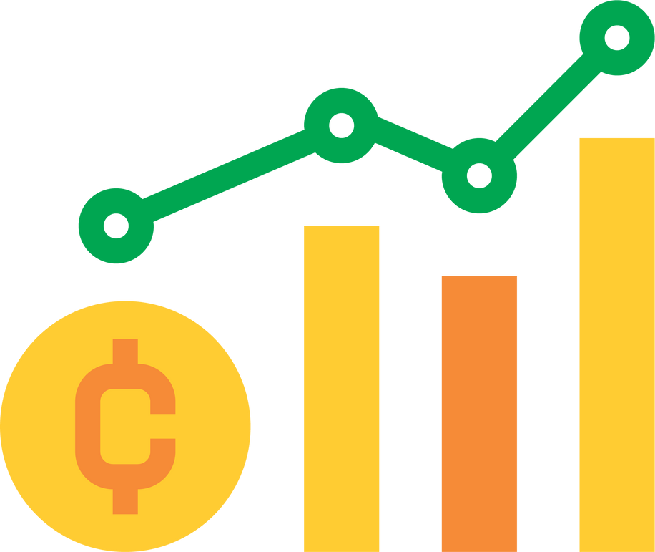
INTRODUCTION
PROJECT OVERVIEW:
A web based platform for managing cryptocurrency portfolios and investments.
It provides dynamic dashboards and real time data of stocks.

Slide 4
1
Frontend : React,HTML,CSS
Backend : Springboot , Spring Security , Spring MVC, Spring Data JPA
2
Technology Stack
Database:
MySQL
3
Software & IDE : Spring tool suite,VS code, Postman.
4
Server : Apache Tomcat
Third Party API : CoinGecko API , News API.

Slide 5
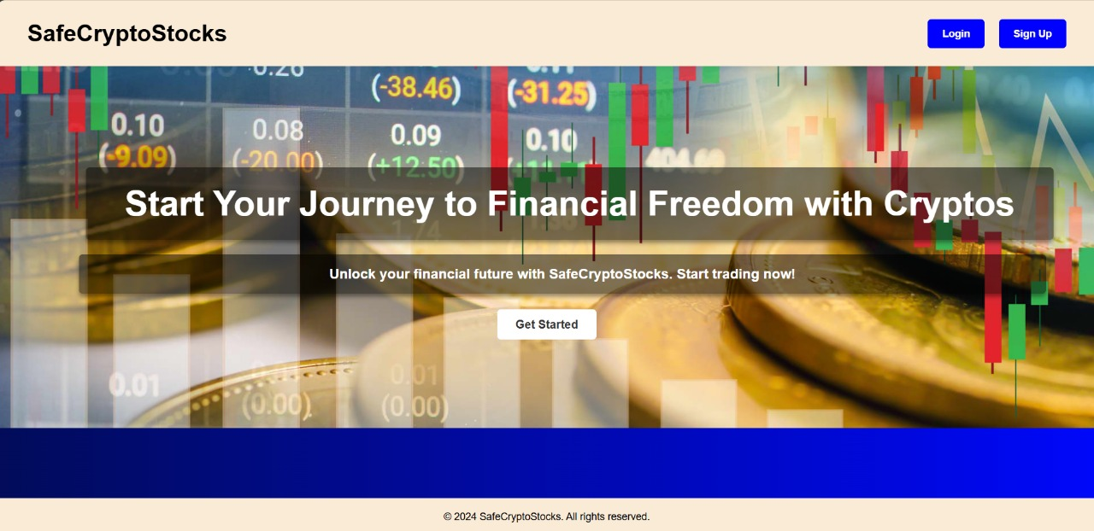
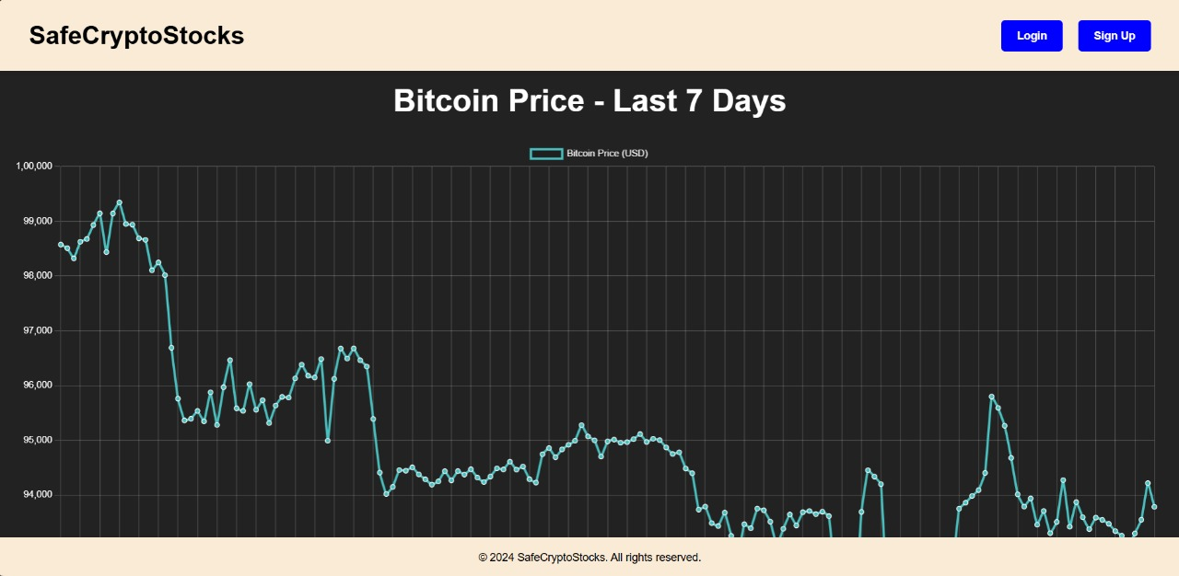
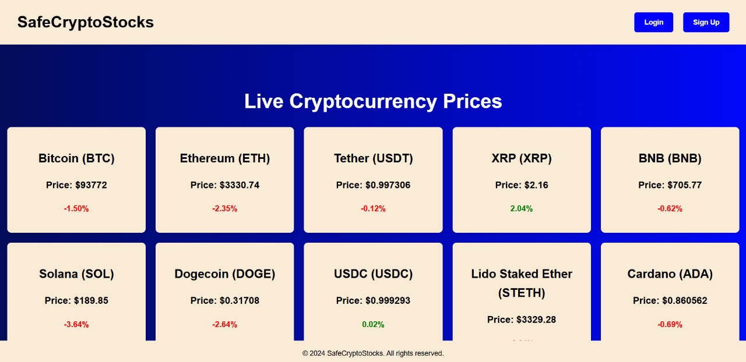
HOME PAGE
Provides an overview of the platform’s features and welcomes users.
Key Features:
Introduction to the platform.
Links to other sections like login or signup.

Slide 6
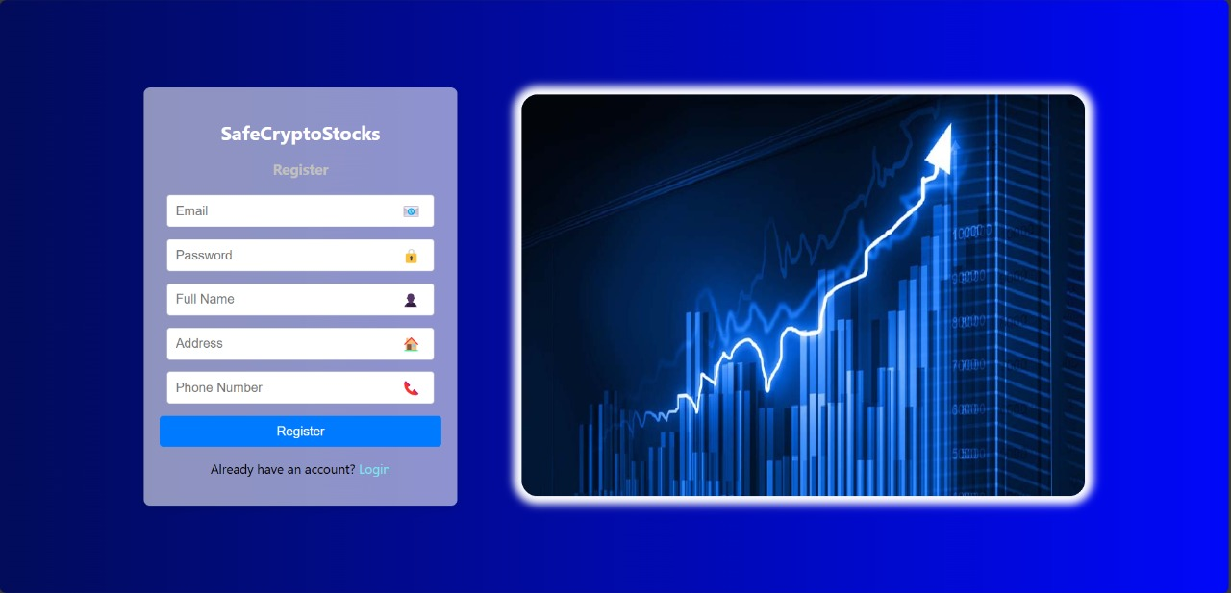
SIGNUP PAGE
Enables new users to register and create accounts
Key Features:
Fields for User Details (name ,email, password).
Password strength checker.
stores user information securely in the database.

Slide 7
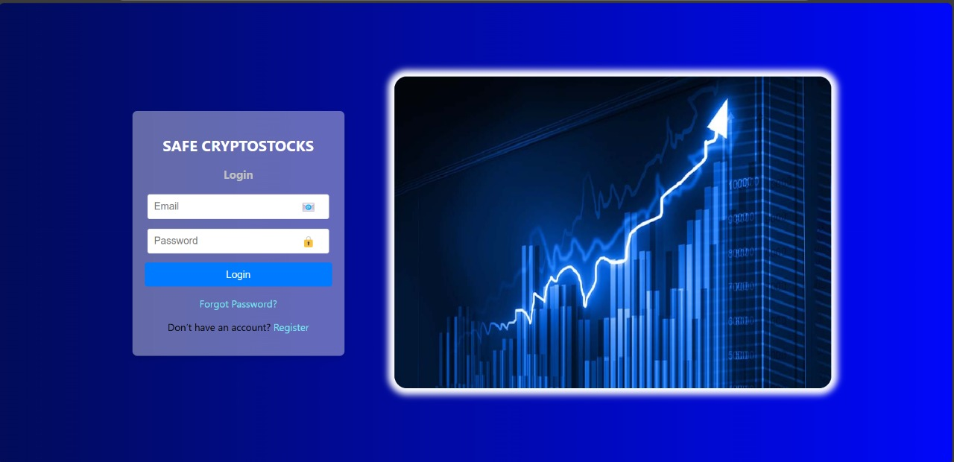
LOGIN PAGE
Allows Users to log in to their accounts securely.
Key Features:
Username and Password fields.
Error messages for invalid credentials.
Redirects to the dashboard upon successful login.

Slide 8
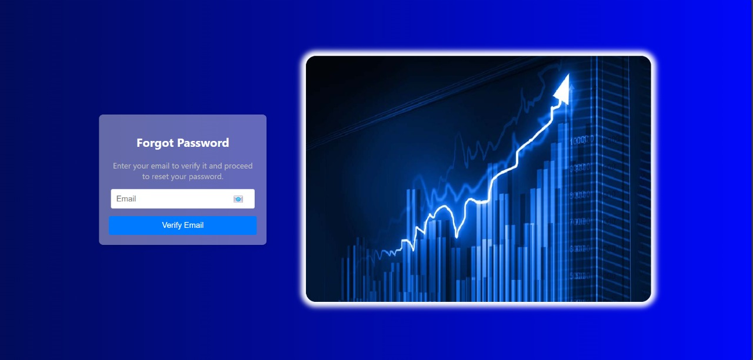
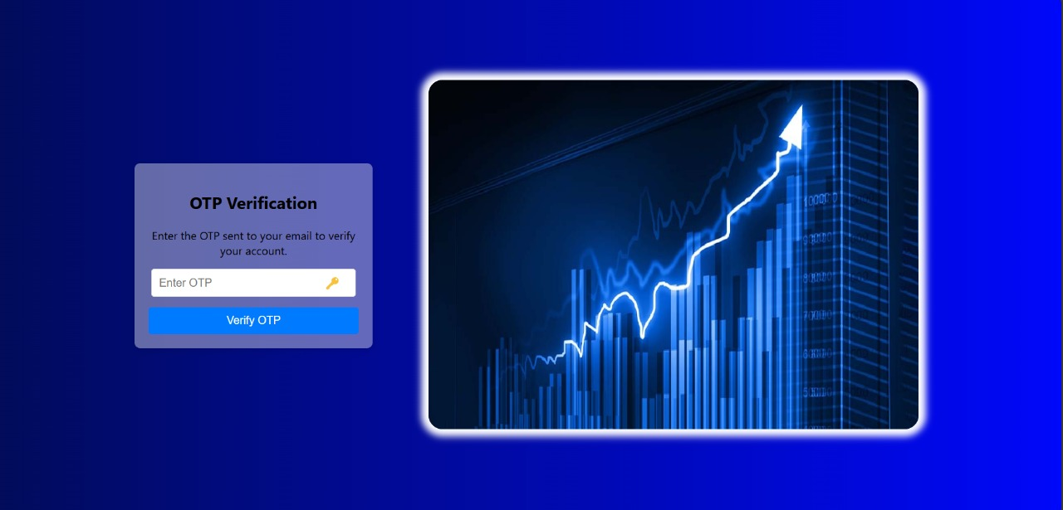
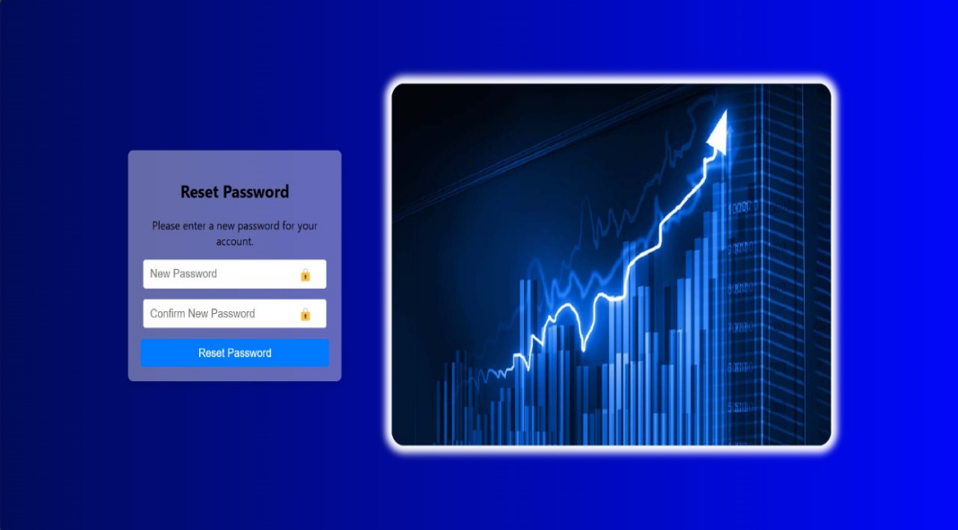
FORGOT AND RESET PASSWORD
This feature allows users to securely reset password using OTP verification through registered email.

Slide 9
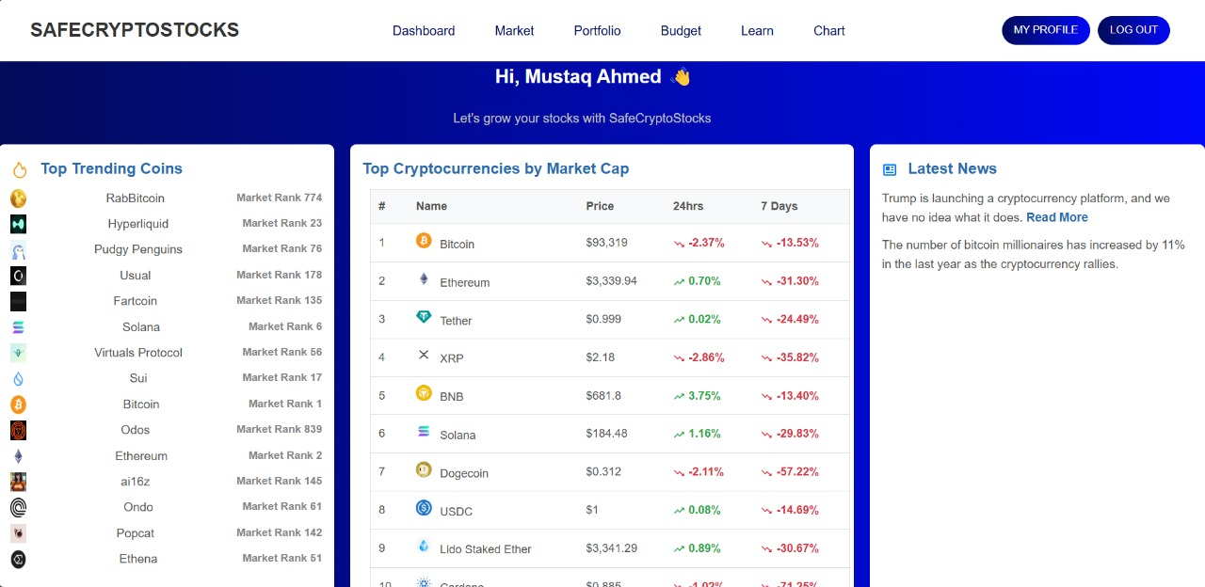
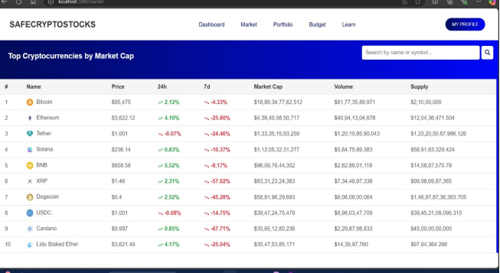
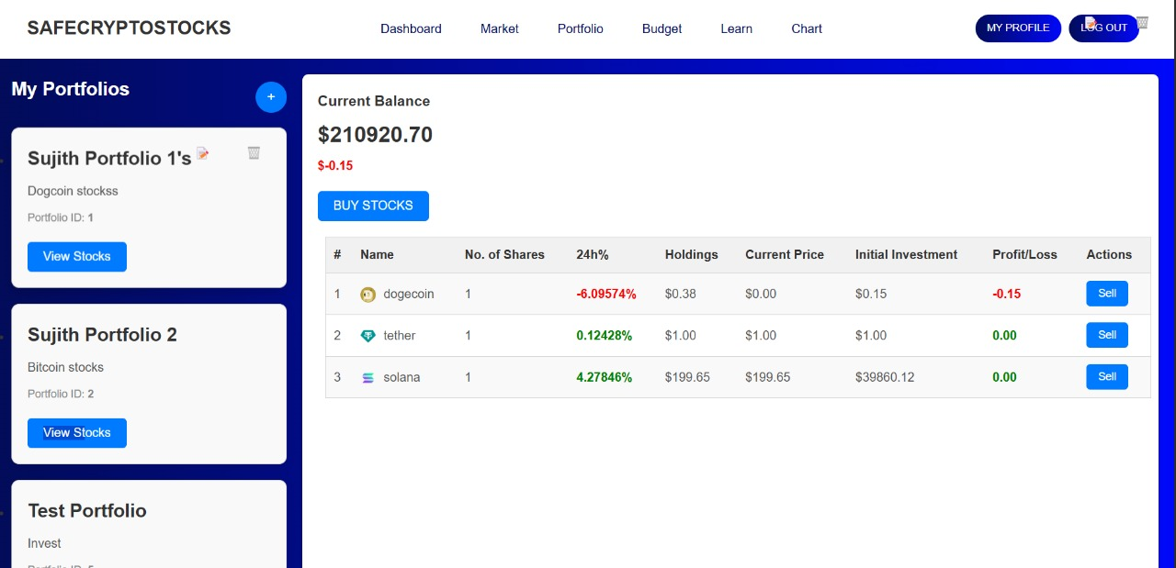
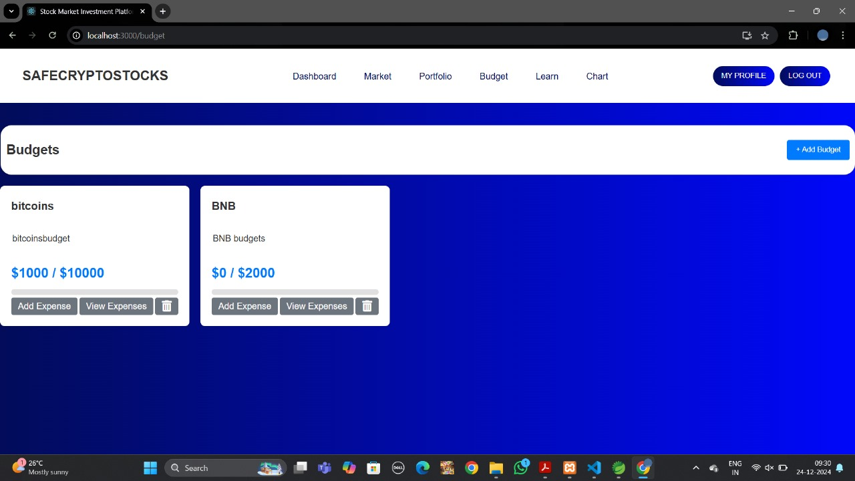
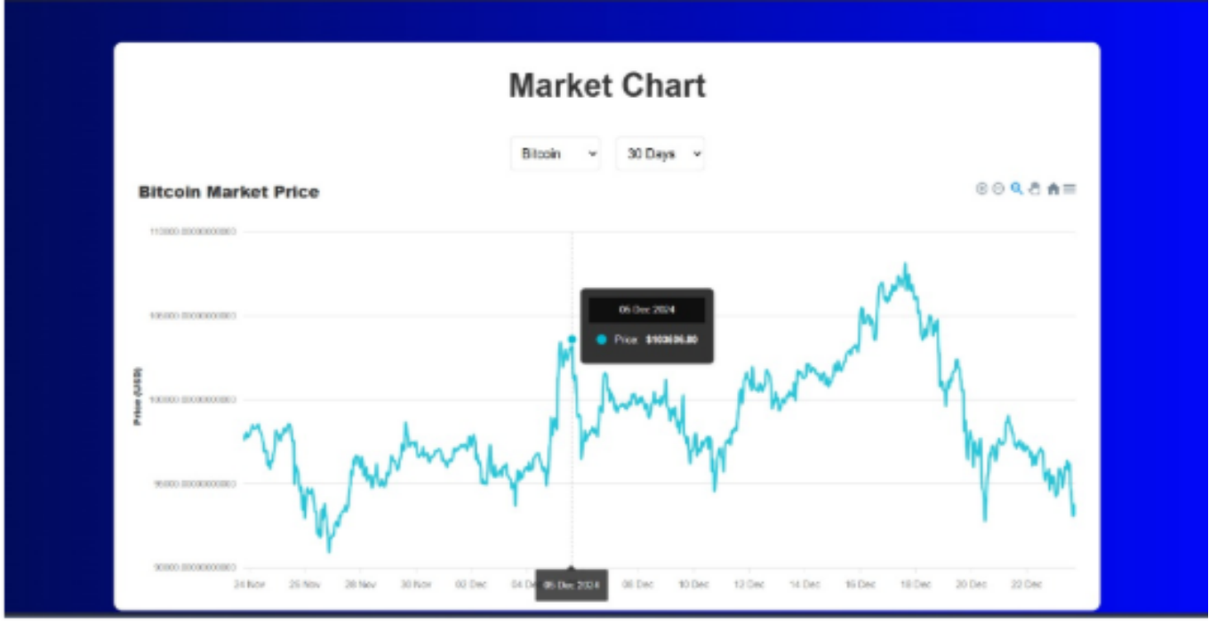
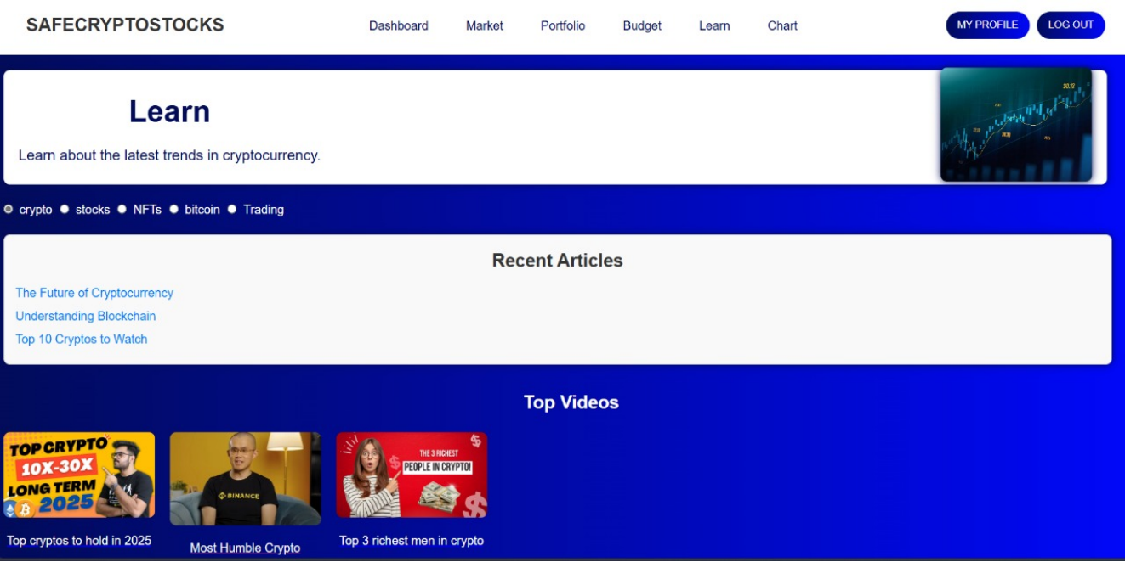
DASHBOARD PAGE

Slide 10
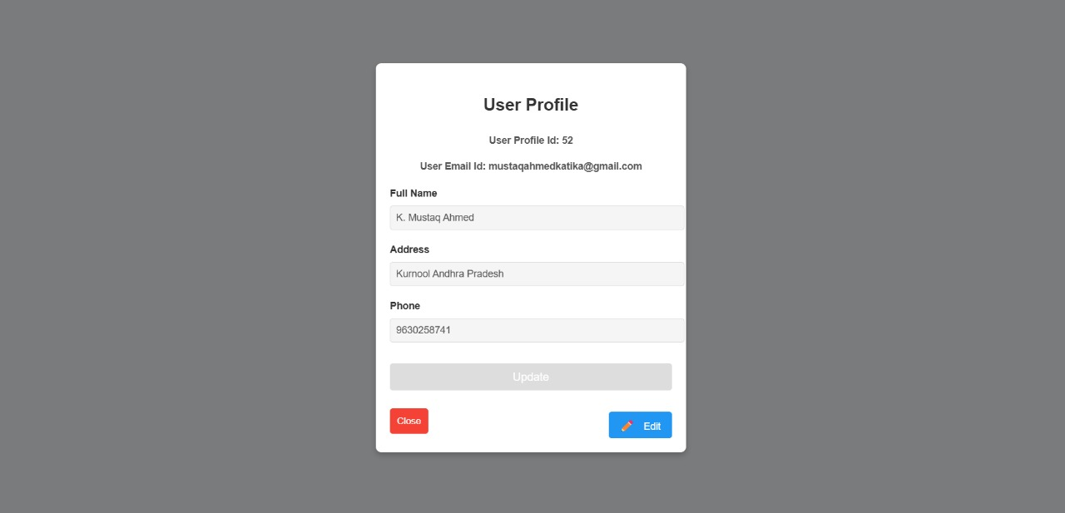
PROFILE PAGE
Displays User profile information.
Key Features:
Shows username , email and account details.
Provides options to edit profile information.
Allows users to logout securely.

Slide 11
CONCLUSION
SafeCryptoStocks simplifies cryptocurrency investments with an intuitive interface,real-time market insights, and secure portfolio management. It empowers users to make informed decisions through interactive dashboards and learning resources.

Slide 12



THANKYOU!
We extend gratitude to our mentor , Raviteja Sripathi sir for valuable guidance and continuous support.

